Slide 1

AFRICAN
SCHOOLS
NETWORK
ROOTED IN AFRICA. READY FOR THE FUTURE.
ASN
An Afrocentric, competency-based education framework that develops values-driven,
future-ready learners for Africa and the world.
EDUCATION
FRAMEWORK
SCHOOL TRANSFORMATION MODEL
FOR AFRICAN SCHOOLS
Transforming Education.
Empowering Africa. Building the Future.
ROOTED IN IDENTITY | DRIVEN BY COMPETENCE | POWERED BY VALUES | COMMITTED TO IMPACT

Slide 2
AFRICAN
SCHOOLS
NETWORK
OUR VISION, MISSION & BELIEFS
ASN
Transforming Education. Empowering Africa. Building the Future.
EDUCATION
FRAMEWORK
OUR VISION
OUR MISSION
OUR BELIEFS
To be the leading network of African schools that provide world-class, values-driven, future-ready education for every child on the continent.
To transform African schools through an Afrocentric, competency-based, innovation-driven education model that develops character, creativity, and competence for impact.
• Africa's identity is our foundation
• Every child can learn and excel
• Education must solve real problems
• Values and character matter
• Collaboration drives transformation
SCHOOL TRANSFORMATION MODEL
FOR AFRICAN SCHOOLS
WHAT THIS MEANS
WHAT THIS MEANS
WHAT THIS MEANS
We envision a future where every African child, regardless of background, has access to quality education that empowers them to thrive, innovate and lead change in their communities and the world.
We equip schools, teachers and learners with the tools, systems and mindset needed to unlock potential, solve real problems and create sustainable impact in Africa and beyond.
We believe education must be holistic, relevant and values-based, preparing learners not just for jobs, but for life, leadership and legacy.
Rooted in our identity.
Driven by competence.
Powered by values.
Committed to impact.
Transforming Education.
Empowering Africa. Building the Future.
OUR VALUES
IDENTITY
Rooted in African heritage, culture, languages
KNOWLEDGE
Pursuing excellence through critical thinking
INNOVATION
Encouraging creativity, STEM and innovation
LEADERSHIP
Developing character, integrity, resilience
IMPACT
Creating positive social, economic impact
ROOTED IN IDENTITY | DRIVEN BY COMPETENCE | POWERED BY VALUES | COMMITTED TO IMPACT

Slide 3
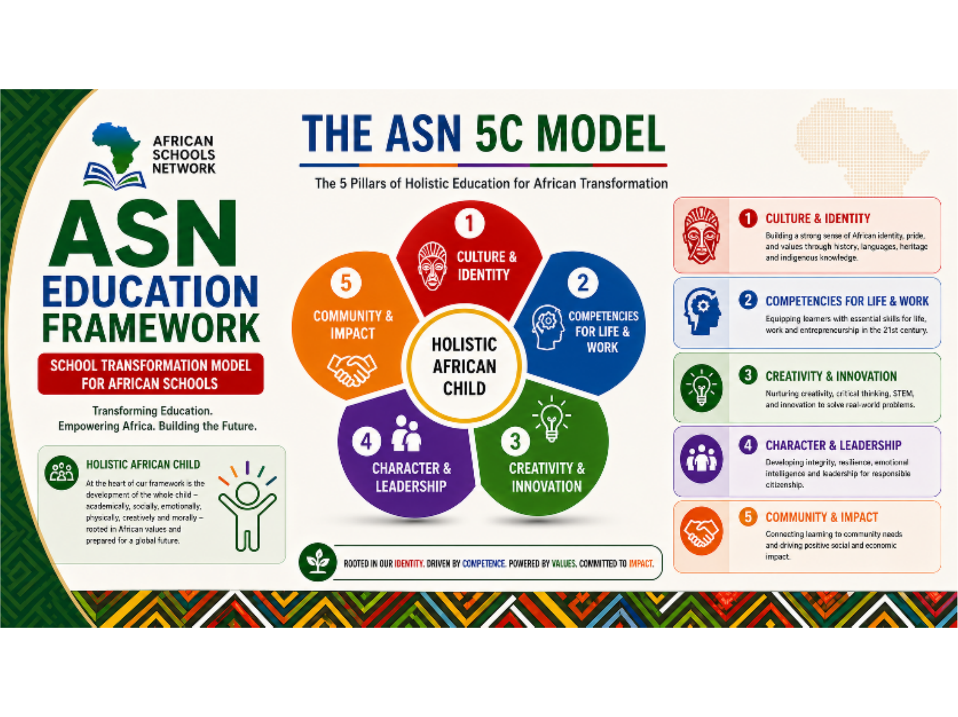
AFRICAN
SCHOOLS
NETWORK
THE ASN 5C MODEL
ASN
The 5 Pillars of Holistic Education for African Transformation
1
CULTURE & IDENTITY
EDUCATION
FRAMEWORK
Building a strong sense of African identity, pride, and values through history, languages, heritage and indigenous knowledge.
SCHOOL TRANSFORMATION MODEL
FOR AFRICAN SCHOOLS
2
COMPETENCIES FOR LIFE & WORK
HOLISTIC AFRICAN CHILD
Equipping learners with essential skills for life, work and entrepreneurship in the 21st century.
At the heart of our framework is the development of the whole child – academically, socially, emotionally, physically, creatively and morally – rooted in African values and prepared for a global future.
3
CREATIVITY & INNOVATION
Nurturing creativity, critical thinking, STEM, and innovation to solve real-world problems.
4
CHARACTER & LEADERSHIP
Developing integrity, resilience, emotional intelligence and leadership for responsible citizenship.
Transforming Education.
Empowering Africa. Building the Future.
5
COMMUNITY & IMPACT
Connecting learning to community needs and driving positive social and economic impact.
ROOTED IN IDENTITY | DRIVEN BY COMPETENCE | POWERED BY VALUES | COMMITTED TO IMPACT

Slide 4
AFRICAN
SCHOOLS
NETWORK
THE 5 PILLARS EXPLAINED
ASN
1
CULTURE & IDENTITY
OUTCOME
EDUCATION
FRAMEWORK
Building a strong sense of African identity, pride, values and connection to history, languages, heritage and indigenous knowledge.
➤
Confident, grounded learners who are proud of who they are and where they come from.
SCHOOL TRANSFORMATION MODEL
FOR AFRICAN SCHOOLS
2
COMPETENCIES FOR LIFE & WORK
OUTCOME
4/12
Equipping learners with essential skills, knowledge and mindset for life, work, and entrepreneurship in the 21st century.
➤
Capable, adaptable and future-ready learners prepared for real-world success.
THE 5 PILLARS
EXPLAINED
3
CREATIVITY & INNOVATION
OUTCOME
The ASN 5C Pillars form the foundation of holistic education that develops the whole child – intellectually, socially, emotionally, physically, creatively and morally – preparing them to thrive and transform Africa and the world.
HOLISTIC AFRICAN CHILD:
Developed. Empowered.
Engaged. Impactful.
Nurturing creativity, curiosity, critical thinking, STEM, and innovation to solve real-world problems and create new opportunities.
➤
Innovative problem solvers who can create solutions and drive progress.
4
CHARACTER & LEADERSHIP
OUTCOME
Developing integrity, resilience, emotional intelligence and leadership for responsible citizenship and ethical decision-making.
➤
Ethical leaders and responsible citizens who inspire trust and create positive change.
Transforming Education.
Empowering Africa. Building the Future.
5
COMMUNITY & IMPACT
OUTCOME
Connecting learning to community needs and driving positive social, environmental and economic impact.
➤
Compassionate change makers building stronger communities and a better Africa.
ROOTED IN IDENTITY | DRIVEN BY COMPETENCE | POWERED BY VALUES | COMMITTED TO IMPACT

Slide 5
AFRICAN
SCHOOLS
NETWORK
TRANSFORMING HOW AFRICAN CHILDREN LEARN
ASN
From teaching at learners to learning with learners.
EDUCATION
FRAMEWORK
FROM (OLD MODEL)
TO (ASN MODEL)
✕ Rote Learning
✔ Application & Understanding
SCHOOL TRANSFORMATION MODEL
FOR AFRICAN SCHOOLS
✕ Teacher-Centered
TRANSFORMING
MINDS.
SHAPING
FUTURES.
✔ Learner-Centered
5/12
✕ Exams Only
✔ Continuous & Competency Assessment
OUR APPROACH TO
TEACHING & LEARNING
✕ Subjects in Isolation
✔ Interdisciplinary & Integrated Learning
We are shifting from traditional, exam-driven education to holistic, learner-centered experiences that build knowledge, skills, character and purpose.
✕ Focus on Content
➤
✔ Focus on Competence, Character & Impact
✕ Success = Marks
✔ Success = Growth, Contribution & Purpose
OUR LEARNING APPROACH
Transforming Education.
Empowering Africa. Building the Future.
PROJECT-BASED
LEARNING
INQUIRY-BASED
LEARNING
EXPERIENTIAL
LEARNING
BLENDED &
TECH-ENHANCED
SOCIO-EMOTIONAL
LEARNING
Real-world projects that build deep understanding and practical skills.
Learners ask, explore and discover — building curiosity and critical thinking.
Learning by doing through experiences that connect classroom to life.
Technology and digital tools to personalize learning and expand access.
Building self-awareness, empathy, resilience and positive relationships.
EVERY LESSON. EVERY LEARNER. EVERY DAY. TRANSFORMING EDUCATION. TRANSFORMING AFRICA.

Slide 6
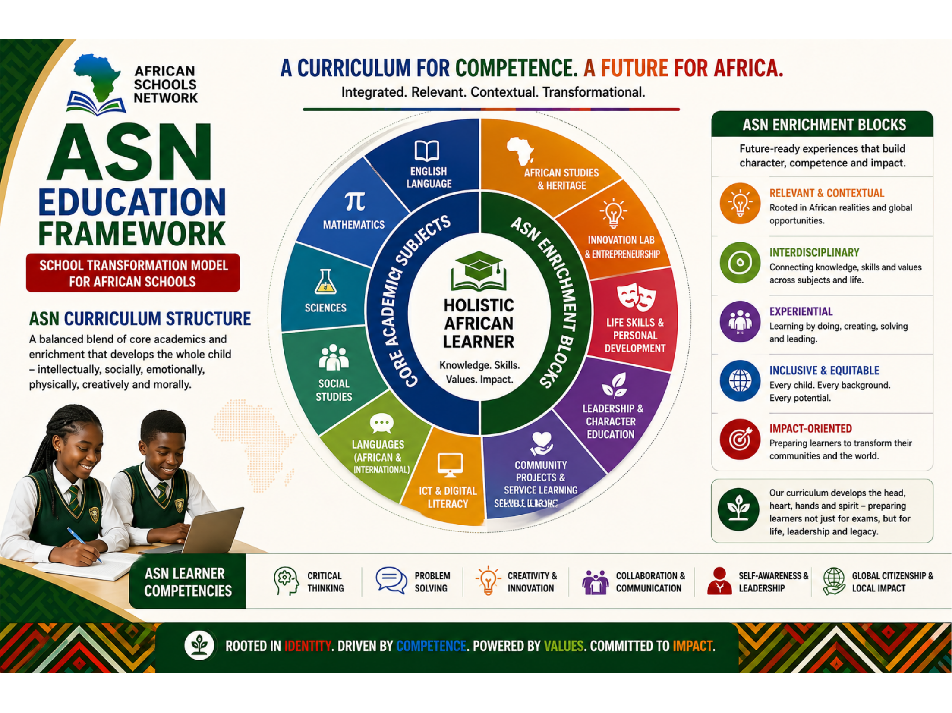
AFRICAN
SCHOOLS
NETWORK
A CURRICULUM FOR COMPETENCE. A FUTURE FOR AFRICA.
ASN
Integrated. Relevant. Contextual. Transformational.
EDUCATION
FRAMEWORK
ASN ENRICHMENT BLOCKS
Future-ready experiences that build character, competence and impact.
SCHOOL TRANSFORMATION MODEL
FOR AFRICAN SCHOOLS
RELEVANT & CONTEXTUAL
Rooted in African realities and global opportunities.
ASN CURRICULUM
STRUCTURE
INTERDISCIPLINARY
Connecting knowledge, skills and values across subjects and life.
A balanced blend of core academics and enrichment that develops the whole child – intellectually, socially, emotionally, physically, creatively and morally.
EXPERIENTIAL
Learning by doing, creating, solving and leading.
INCLUSIVE & EQUITABLE
Every child. Every background. Every potential.
Transforming Education.
Empowering Africa. Building the Future.
IMPACT-ORIENTED
Preparing learners to transform their communities and the world.
ROOTED IN IDENTITY | DRIVEN BY COMPETENCE | POWERED BY VALUES | COMMITTED TO IMPACT

Slide 7
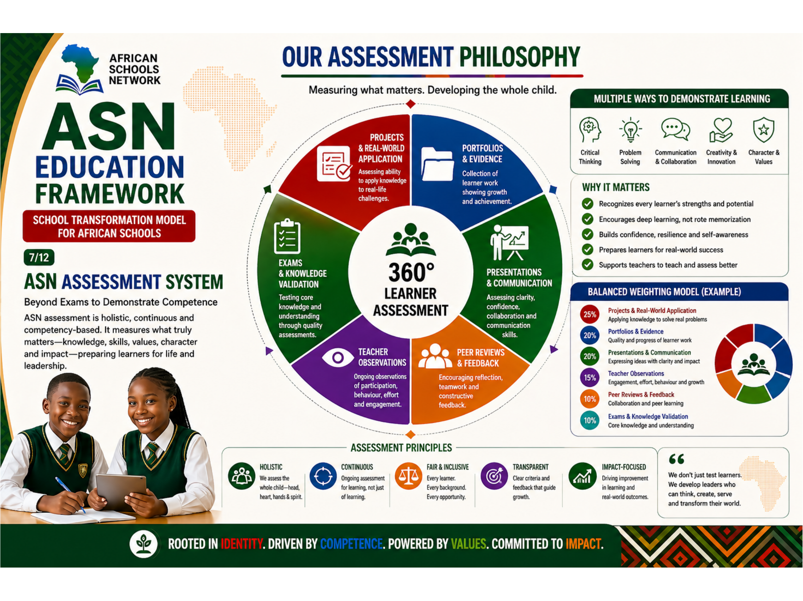
AFRICAN
SCHOOLS
NETWORK
OUR ASSESSMENT PHILOSOPHY
ASN
Measuring what matters. Developing the whole child.
MULTIPLE WAYS TO DEMONSTRATE LEARNING
EDUCATION
FRAMEWORK
Critical Thinking
Problem Solving
Communication
& Collaboration
Creativity &
Innovation
Character &
Values
SCHOOL TRANSFORMATION MODEL
FOR AFRICAN SCHOOLS
WHY IT MATTERS
✔ Recognizes every learner's strengths and potential
7/12
✔ Encourages deep learning, not rote memorization
ASN ASSESSMENT
SYSTEM
✔ Builds confidence, resilience and self-awareness
✔ Prepares learners for real-world success
✔ Supports teachers to teach and assess better
Beyond Exams to Demonstrate Competence.
ASN assessment is holistic, continuous and competency-based. It measures what truly matters—knowledge, skills, values, character and impact—preparing learners for life and leadership.
BALANCED WEIGHTING MODEL
25%
Projects & Real-World Application
20%
Portfolios & Evidence
20%
Presentations & Communication
Transforming Education.
Empowering Africa. Building the Future.
15%
Teacher Observations
10%
Peer Reviews & Feedback
10%
Exams & Knowledge Validation
ROOTED IN IDENTITY | DRIVEN BY COMPETENCE | POWERED BY VALUES | COMMITTED TO IMPACT

Slide 8
AFRICAN
SCHOOLS
NETWORK
TRANSFORMING TEACHERS. TRANSFORMING AFRICA.
ASN
From Instructors of Content to Architects of Transformation.
EDUCATION
FRAMEWORK
THE TRADITIONAL TEACHER
THE ASN TEACHER
ASN TEACHER COMPETENCIES
✕ Teacher-Centered
✔ Learner-Centered Facilitator
PEDAGOGICAL EXCELLENCE
Designing engaging, learner-centered and competency-based lessons.
SCHOOL TRANSFORMATION MODEL
FOR AFRICAN SCHOOLS
✕ Focus on Content Delivery
✔ Focus on Competence & Growth
DIGITAL & INNOVATION SKILLS
✕ One-Size-Fits-All Approach
✔ Differentiated & Inclusive Approach
Leveraging technology and innovation to enhance learning.
8/12
➤
TEACHER
TRANSFORMATION
SOCIO-EMOTIONAL INTELLIGENCE
✕ Rote Learning & Memorization
✔ Deep Learning & Critical Thinking
Building strong relationships and supporting the well-being of every learner.
✕ Limited Use of Technology
✔ Technology-Enhanced Learning
AFROCENTRIC MINDSET
Rooted in African identity, values, history and indigenous knowledge.
Teachers are the heartbeat of transformation.
ASN empowers teachers to become facilitators of learning, mentors of character and coaches for life—equipped with the skills, mindset and values to inspire every learner.
LEADERSHIP & MENTORING
✕ Assesses to Rank
✔ Assesses to Improve & Grow
Inspiring learners, guiding character and building future leaders.
✕ Works in Isolation
✔ Collaborates & Builds Community
COLLABORATION & COMMUNITY
Working with peers, parents and communities for collective impact.
THE ASN TEACHER ROLES
FACILITATOR
of Learning
MENTOR
of Character
COACH
for Growth
DESIGNER
of Experiences
CHANGE AGENT
for Impact
Transforming Education.
Empowering Africa. Building the Future.
Creates engaging experiences that unlock every learner's potential.
Guides learners to build integrity, values and strong life choices.
Supports learners to set goals, overcome challenges and achieve more.
Plans meaningful, real-world learning that builds skills and confidence.
Leads transformation in classrooms, schools and communities.
ROOTED IN IDENTITY | DRIVEN BY COMPETENCE | POWERED BY VALUES | COMMITTED TO IMPACT

Slide 9
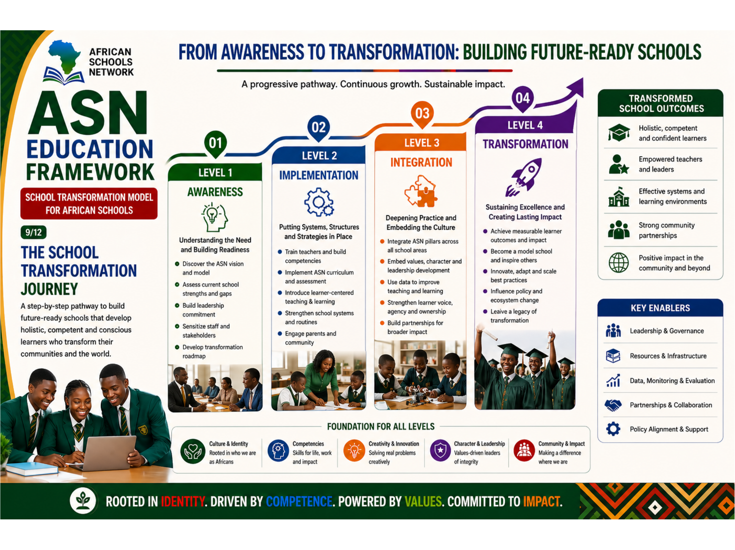
AFRICAN
SCHOOLS
NETWORK
FROM AWARENESS TO TRANSFORMATION: BUILDING FUTURE-READY SCHOOLS
ASN
A progressive pathway. Continuous growth. Sustainable impact.
EDUCATION
FRAMEWORK
TRANSFORMED SCHOOL OUTCOMES
✔ Holistic, competent and confident learners
SCHOOL TRANSFORMATION MODEL
FOR AFRICAN SCHOOLS
✔ Empowered teachers and leaders
9/12
✔ Effective systems and learning environments
THE SCHOOL
TRANSFORMATION
JOURNEY
✔ Strong community partnerships
✔ Positive impact in the community and beyond
A step-by-step pathway to build future-ready schools that develop holistic, competent and conscious learners who transform their communities and the world.
KEY ENABLERS
◆ Leadership & Governance
◆ Resources & Infrastructure
Transforming Education.
Empowering Africa. Building the Future.
◆ Data, Monitoring & Evaluation
◆ Partnerships & Collaboration
◆ Policy Alignment & Support
ROOTED IN IDENTITY | DRIVEN BY COMPETENCE | POWERED BY VALUES | COMMITTED TO IMPACT

Slide 10
AFRICAN
SCHOOLS
NETWORK
IMPLEMENTING TRANSFORMATION. DELIVERING RESULTS.
ASN
Comprehensive tools to support every school, every teacher, every learner.
EDUCATION
FRAMEWORK
THE ASN IMPLEMENTATION TOOLKIT
1
ASN CURRICULUM GUIDES
2
LESSON PLAN TEMPLATES
3
PROJECT-BASED LEARNING PACKS
4
TEACHER TRAINING & PD MODULES
5
ASSESSMENT TOOLS
SCHOOL TRANSFORMATION MODEL
FOR AFRICAN SCHOOLS
Grade-level curriculum maps
Learning outcomes & indicators
Suggested learning activities
Cross-curricular integration
Competency-based lesson plans
Differentiated instruction
Inquiry & project-based learning
Built-in assessment strategies
Real-world project guides
Research & inquiry tools
Student worksheets
Presentation rubrics
Blended professional development
Pedagogy & subject training
Leadership & mindset growth
Continuous coaching support
Rubrics & checklists
Performance tasks
Portfolios & journals
Digital assessment tools
10/12
OUR IMPLEMENTATION
TOOLS
Practical. Proven. Powerful.
ASN provides schools with a comprehensive toolkit to plan, teach, assess, lead and improve — every step of the way.
6
DIGITAL LEARNING RESOURCES
7
SCHOOL LEADERSHIP TOOLS
8
PARENT & COMMUNITY ENGAGEMENT
9
MONITORING & EVALUATION TOOLS
10
POLICY & SYSTEM ALIGNMENT TOOLS
E-books, videos & simulations
Interactive learning apps
Offline & low-bandwidth options
Curated Afrocentric content
Strategic planning templates
Policy & governance guides
School self-evaluation tools
Data-driven decision making
Engagement guides
Communication templates
Volunteer & partnership toolkit
Community project ideas
School progress dashboards
Key indicators & benchmarks
Observation & feedback forms
Impact measurement tools
Policy alignment guides
Standards & compliance tools
Reporting templates
Advocacy & policy briefs
Transforming Education.
Empowering Africa. Building the Future.
POWERED BY TOOLS | GUIDED BY PURPOSE | DRIVEN BY TRANSFORMATION

Slide 11
AFRICAN
SCHOOLS
NETWORK
THE IMPACT WE CREATE. THE LEGACY WE LEAVE.
ASN
Holistic learners. Strong schools. Thriving communities. A better Africa.
EDUCATION
FRAMEWORK
IMPACT ON LEARNERS
CONFIDENT
LEARNERS
FUTURE-READY
COMPETENCIES
CREATIVE &
INNOVATIVE
STRONG CHARACTER
& LEADERSHIP
COMMUNITY &
GLOBAL IMPACT
LIFELONG LEARNERS
& ADAPTABLE
SCHOOL TRANSFORMATION MODEL
FOR AFRICAN SCHOOLS
Strong identity, self-belief and purpose.
Critical thinking, problem solving, digital skills and real-world competence.
Curious minds that innovate, create and solve real problems.
Integrity, empathy, resilience and leadership for impact.
Responsible citizens building stronger communities and nations.
Adaptable, resilient and prepared for a changing world.
11/12
OUR IMPACT.
OUR FUTURE.
ASN transforms schools today to build a better Africa tomorrow.
Our framework develops well-rounded, competent, confident and conscious learners who create solutions, lead change and build thriving communities.
KEY OUTCOMES
HOLISTIC
DEVELOPMENT
21ST CENTURY
SKILLS
HIGH
ACHIEVEMENT
LEADERSHIP
PIPELINE
POSITIVE
IMPACT
AFRICA'S
FUTURE
Mind, body, heart and spirit.
Learners equipped for life and work.
Improved academic and real-world performance.
Young leaders prepared to transform communities.
Creating value and solving problems that matter.
Building the Africa we envision—together.
Transforming Education.
Empowering Africa. Building the Future.
ROOTED IN IDENTITY | DRIVEN BY COMPETENCE | POWERED BY VALUES | COMMITTED TO IMPACT

Slide 12
AFRICAN
SCHOOLS
NETWORK
JOIN THE MOVEMENT. TRANSFORM AFRICA.
ASN
Together, We Can Build the Future Our Children Deserve.
The ASN Education Framework is more than a model—it is a movement for transformation,
driven by purpose, powered by people, and sustained by partnership.
EDUCATION
FRAMEWORK
FOUR WAYS TO TAKE ACTION TODAY
1. ADOPT THE FRAMEWORK
2. PARTNER WITH ASN
3. SUPPORT THE MOVEMENT
4. ADVOCATE FOR CHANGE
SCHOOL TRANSFORMATION MODEL
FOR AFRICAN SCHOOLS
Bring ASN to your school.
Let's achieve more together.
Invest in Africa's future.
Raise your voice. Inspire others.
12/12
• Access the complete ASN toolkit
• Train your teachers
• Implement the model step-by-step
• Transform learning and outcomes
• Strategic partnerships
• Curriculum & content collaboration
• Research & innovation
• Capacity building & training
• Sponsor schools & scholarships
• Fund innovation & learning projects
• Support teacher development
• Drive impact in communities
• Champion quality education
• Influence policy & systems
• Share the ASN vision
• Mobilize your network
Be Part of the
Change.
Be Part of the
Future.
Every child. Every school. Every community. Together, we can build a generation of ethical leaders, innovators and problem solvers who will drive Africa's transformation.
TRANSFORM YOUR SCHOOL. Shape the future.
TOGETHER, WE CAN SCALE TRANSFORMATION.
YOUR SUPPORT CREATES LASTING IMPACT.
BE A VOICE FOR TRANSFORMATION.
Transforming Education.
Empowering Africa. Building the Future.
"The future of Africa depends on the quality of education we provide today.
Let's build it—together."
🌐 www.africanschoolsnetwork.org
✉ info@africanschoolsnetwork.org
📞 +256 771 123 456
SCHOOLS
(Public, Private & Faith)
EDUCATORS
(Teachers, Leaders)
ORGANIZATIONS
(NGOs, Foundations)
GOVERNMENTS
(Ministries, Agencies)
BUSINESSES
(Companies, SMEs)
PARENTS &
COMMUNITIES
ONE VISION. ONE FRAMEWORK. ONE MOVEMENT. ENDLESS POSSIBILITIES.
TOGETHER, WE WILL BUILD A BETTER AFRICA. It Starts With Education.

